Slide 1


Eduard Codrean
23.02.2023

Slide 2

Outline
Executive Summary
Introduction
Methodology
Results
Conclusion
Appendix

Slide 3
Executive Summary
Summary of methodologies
- Data Collection through API
- Data Collection with Web Scraping
- Data Wrangling
- Exploratory Data Analysis with SQL
- Exploratory Data Analysis with Data Visualization
- Interactive Visual Analytics with Folium
- Machine Learning Prediction
Summary of all results
- Exploratory Data Analysis result
- Interactive Analytics with Maps and Dashboards
- Predictive Analytics result with Machine Learning

Slide 4
Introduction
Project background and context
SpaceX is a revolutionary company who has disrupt the space industry by offering a rocket launches specifically Falcon 9 as low as 62 million dollars; while other providers cost upward of 165 million dollar each. Most of this saving thanks to SpaceX astounding idea to reuse the first stage of the launch by re-land the rocket to be used on the next mission. Repeating this process will make the price down even further. As a data scientist of a startup rivaling SpaceX, the goal of this project is to create the machine learning pipeline to predict the landing outcome of the first stage in the future. This project is crucial in identifying the right price to bid against SpaceX for a rocket launch. The problems included:
Problems we want to find answers:
• Identifying all factors that influence the landing outcome.
• The relationship between each variables and how it is affecting the outcome.
• The best condition needed to increase the probability of successful landing.

Slide 5

Section 1

Slide 6
Methodology
Executive Summary
Data collection methodology:
Data was collected using SpaceX REST API and web scrapping from Wikipedia
Perform data wrangling
Data was processed using one-hot encoding for categorical features
Perform exploratory data analysis (EDA) using visualization and SQL
Perform interactive visual analytics using Folium and Plotly Dash
Perform predictive analysis using classification models
How to build, tune, evaluate classification models

Slide 7
Data Collection
Data collection involves gathering and measuring information on specific variables within a system, allowing for the evaluation of outcomes and the answering of relevant questions. The dataset in question was collected from Wikipedia through REST API and web scraping.
For the REST API component, a GET request was utilized to obtain the necessary data, which was then converted to a pandas DataFrame using json_normalize(). The collected data was then cleaned, and missing values were identified and addressed as necessary.
In the case of web scraping, the BeautifulSoup library was used to extract launch records from an HTML table. The table was parsed and converted to a pandas DataFrame for analysis purposes.
Data cleaning and preprocessing are crucial in the data preparation process, ensuring that data is accurate, complete, and suitable for analysis.

Slide 8
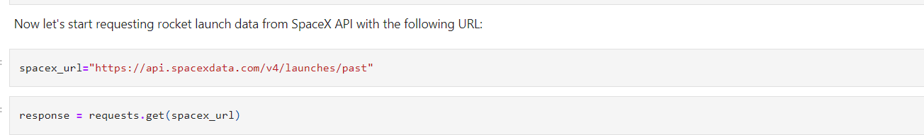
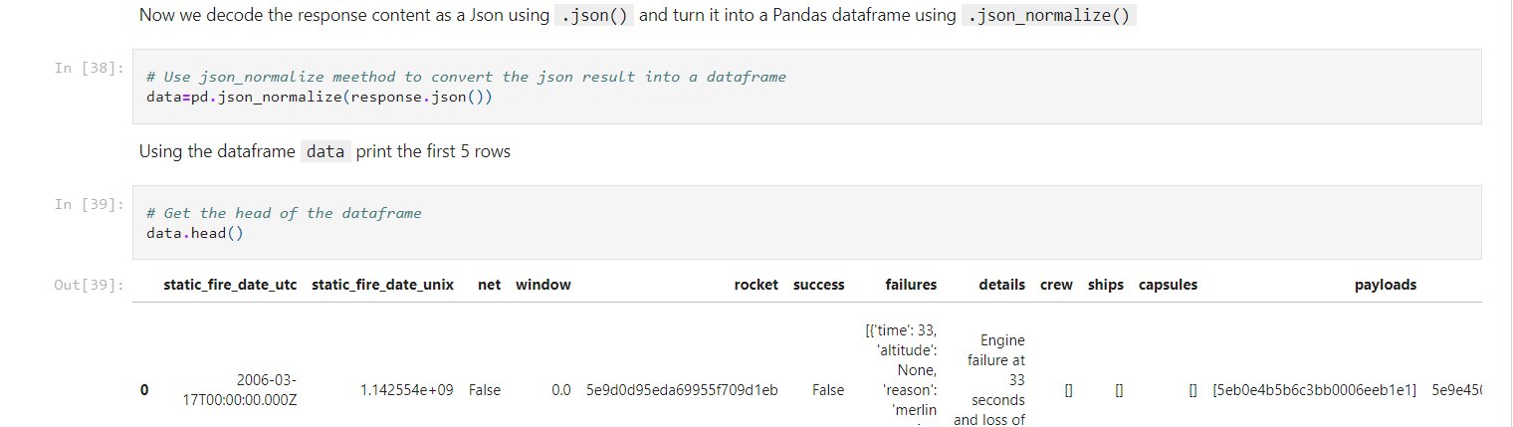
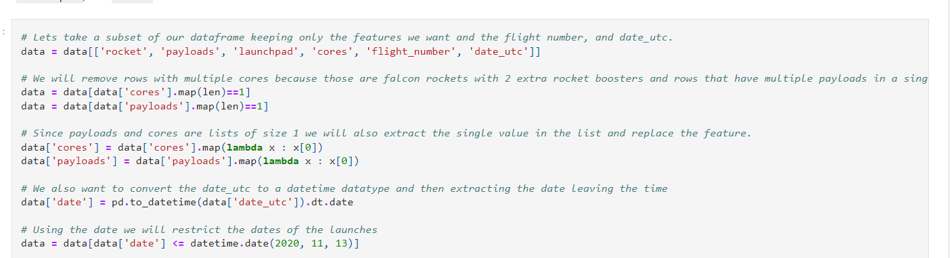
Data Collection – SpaceX API
Get request for rocket launch data using API
Use json_normalize method to convert json result to dataframe
Performed data cleaning and filling the missing value
GitHub URL of the SpaceX API calls notebook

Slide 9
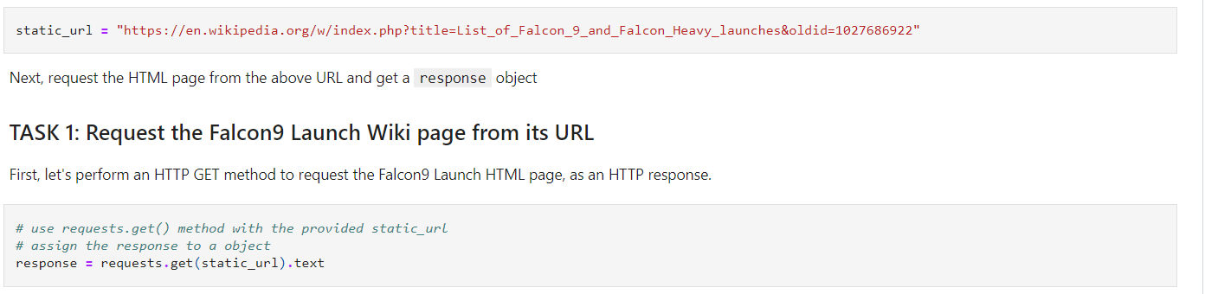
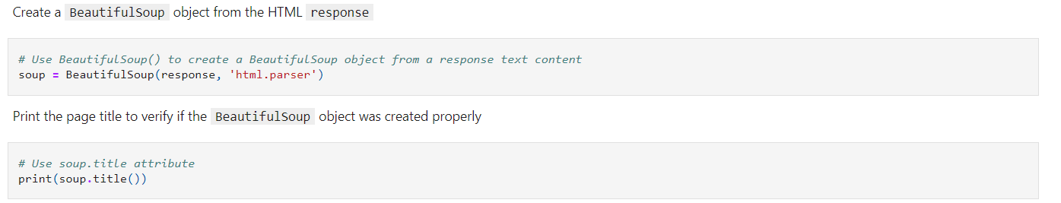
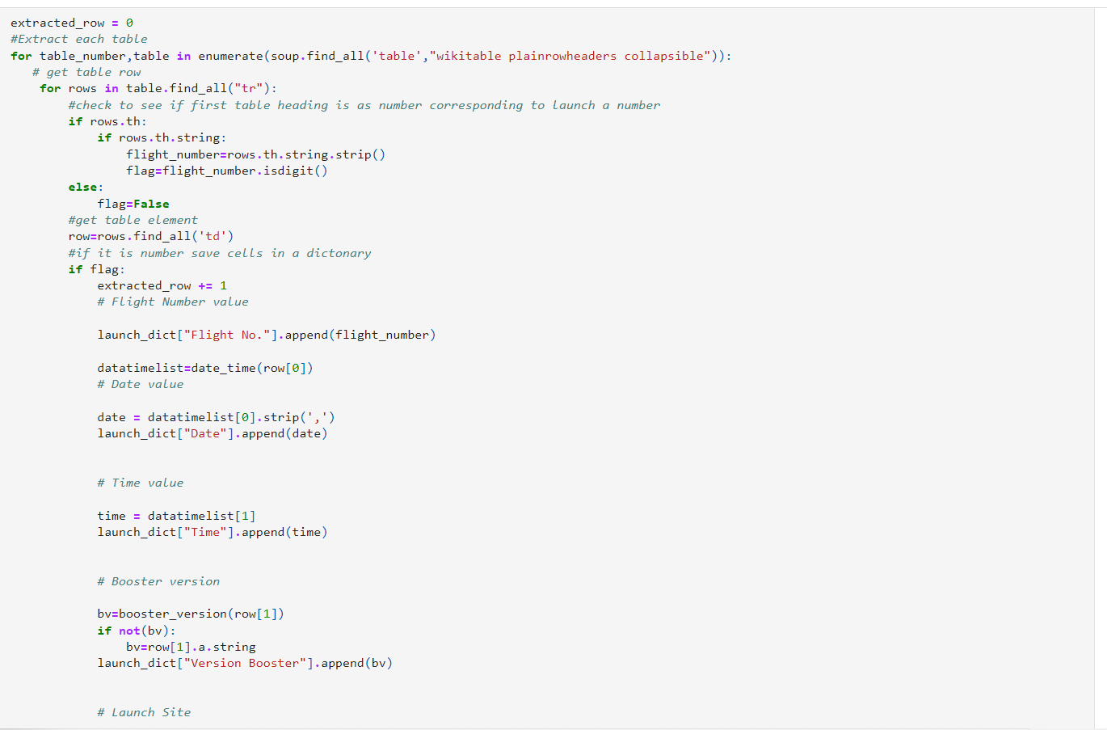
Data Collection - Scraping
Request the Falcon9 Launch Wiki page from url
Create a BeautifulSoup from the HTML response
Extract all column/variable names from the HTML header
GitHub URL of the web scraping notebook

Slide 10

Data Wrangling
Data wrangling involves cleaning and transforming complex and disorganized data sets for easier access and analysis through exploratory data analysis.
In this specific case, several important data wrangling tasks need to be performed. These include calculating the number of launches on each site, determining the number and occurrence of mission outcomes per orbit type, and creating a landing outcome label from the outcome column. These tasks will make further analysis, visualization, and machine learning more straightforward and more accurate.
Finally, the results of the data wrangling will be exported to a CSV file for further use. By performing these tasks, the data will be structured, complete, and accurate, making it easier to gain valuable insights and make informed decisions based on the findings.
GitHub URL of data wrangling Notebook

Slide 11
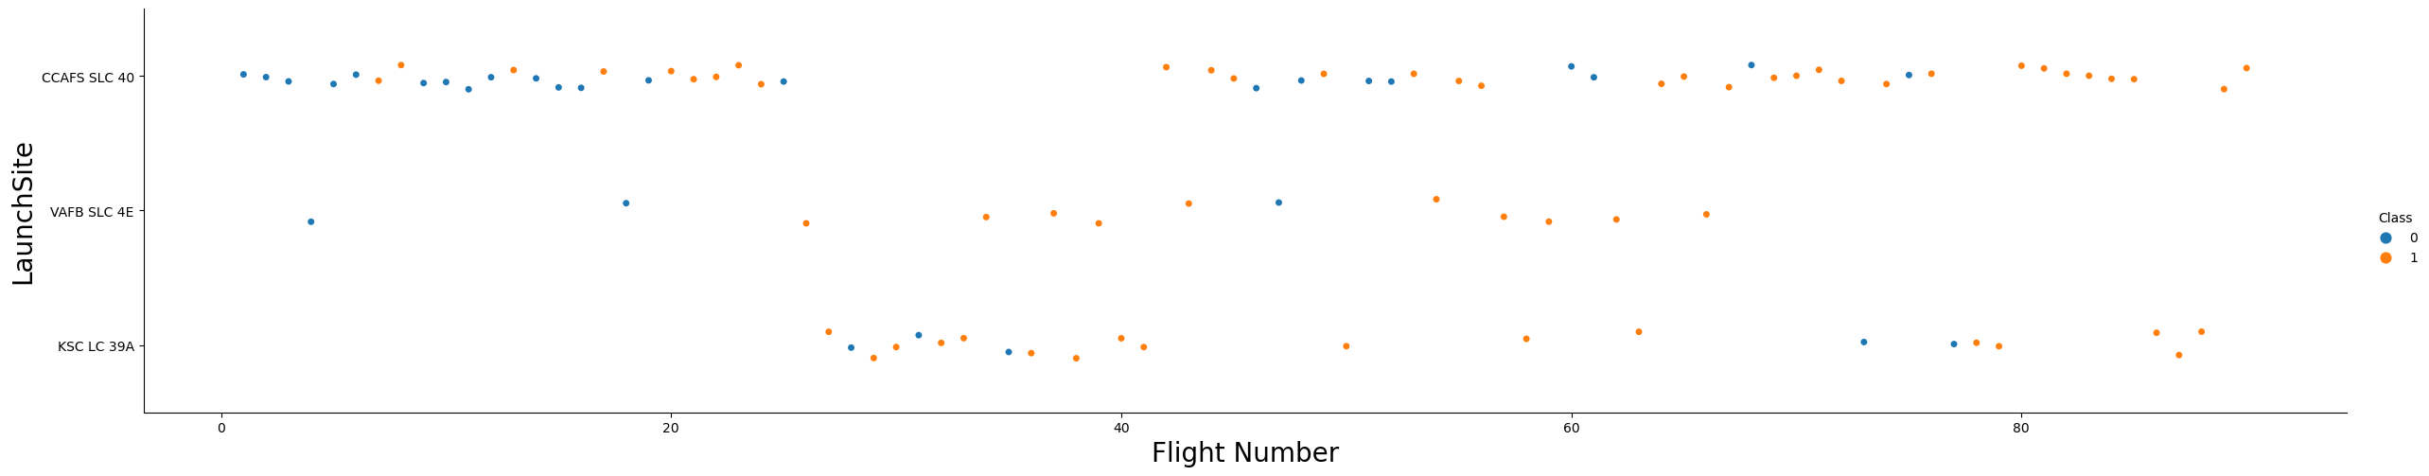
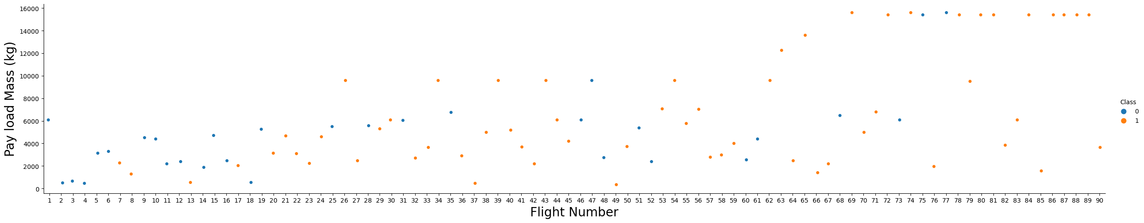
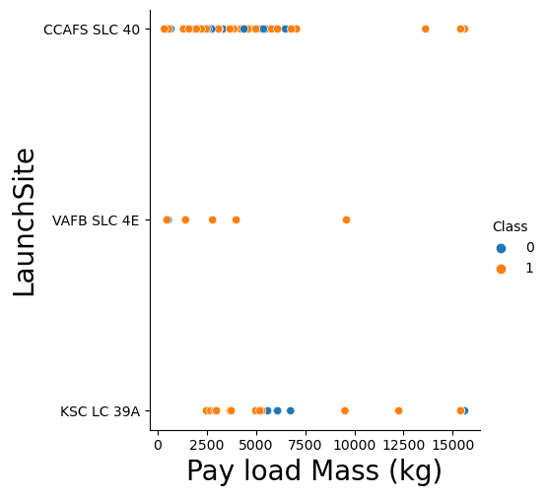
EDA with Data Visualization
To understand the relationship between different attributes, we started by using scatter graphs. We looked at the relationships between payload and flight number, flight number and launch site, payload and launch site, flight number and orbit type, and payload and orbit type. By creating these scatter plots, we were able to see the dependency of attributes on each other.
Once we identified a pattern from the graphs, it was much easier to see which factors had the most significant impact on the success of the landing outcomes. By analyzing these patterns and understanding the dependencies between attributes, we gained valuable insights that could help us improve future mission outcomes. The use of scatter graphs allowed us to visualize the relationships between different variables, making it easier to understand and interpret the data.
GitHub URL of EDA with data visualization notebook

Slide 12
EDA with SQL
Using SQL, we had performed many queries to get better understanding of the dataset:
Displaying the names of the launch sites.
Displaying 5 records where launch sites begin with the string ‘CCA’.
Displaying the total payload mass carried by booster launched by NASA (CRS).
Displaying the average payload mass carried by booster version F9 v1.1.
Listing the date when the first successful landing outcome in ground pad was achieved.
Listing the names of the boosters which have success in drone ship and have payload mass greater than 4000 but less than 6000.
Listing the total number of successful and failure mission outcomes.
Listing the names of the booster_versions which have carried the maximum payload mass.
Listing the failed landing_outcomes in drone ship, their booster versions, and launch sites names for in year 2015.
Rank the count of landing outcomes or success between the date 2010-06-04 and 2017-03-20, in descending order.
These SQL queries helped us gain insights into the dataset and identify trends and patterns that could be used to make informed decisions based on the findings.
GitHub URL of EDA with SQL notebook

Slide 13
Build an Interactive Map with Folium
To visualize the launch data in an interactive way, we used latitude and longitude coordinates to plot circle markers around each launch site on a map. The markers were labeled with the name of the launch site. We also assigned the launch outcomes, either success or failure, to classes 0 and 1, respectively. We used Red and Green markers on the map to represent the outcomes, which were grouped using MarkerCluster().
To further explore the data, we calculated the distance of each launch site to various landmarks using Haversine’s formula. This helped us answer questions such as, how close are the launch sites to railways, highways, coastlines, and nearby cities. By doing this, we were able to gain a better understanding of the relationships between the launch sites and their surroundings, which could help inform decisions related to launch planning and logistics.
GitHub URL of interactive map with Folium map

Slide 14
Build a Dashboard with Plotly Dash
Using Plotly dash, we created an interactive dashboard that allows users to explore the launch data in a customizable way. We included several visualizations, such as pie charts that display the total number of launches by specific sites. Additionally, we created scatter graphs that show the relationship between the outcome of a launch and the payload mass (measured in Kg) for different booster versions. These visualizations provide a more intuitive and accessible way to analyze the data, allowing users to easily identify patterns and trends. This can help inform decisions related to launch planning and resource allocation.
GitHub URL of Plotly Dash Application

Slide 15
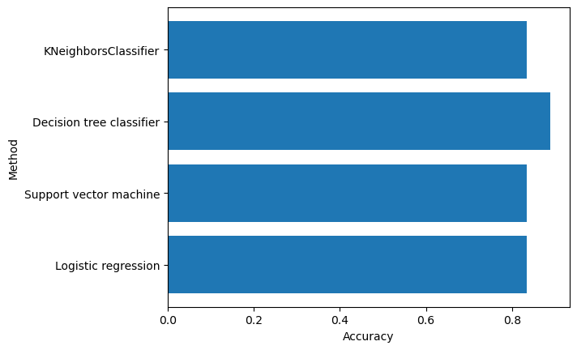
Predictive Analysis (Classification)
Building the Model
Load the dataset: This involves importing the dataset into NumPy and Pandas, which are popular Python libraries for data manipulation.
Data preparation: This step involves cleaning and transforming the data so that it can be used for modeling. It also involves splitting the data into training and test datasets.
Choosing a Machine Learning (ML) algorithm: There are many types of ML algorithms, such as regression, classification, clustering, and others. The choice of algorithm depends on the problem being solved and the characteristics of the data.
Setting the parameters: Many ML algorithms have parameters that need to be set before training the model. GridSearchCV is a popular method for tuning the hyperparameters of an algorithm.
Fitting the model: The final step is to fit the model to the training data using the selected algorithm and parameters. This involves training the model on the training dataset and testing its performance on the test dataset.
In evaluating the model, there are several steps that need to be taken.
Next, we need to get the tuned hyperparameters for each type of algorithm. This involves finding the optimal values for the various parameters that are used in the machine learning algorithm. We can use techniques such as GridSearchCV to do this.
Finally, we need to plot the confusion matrix to see how well the model is performing. The confusion matrix shows the number of true positives, false positives, true negatives, and false negatives. This can help us identify any issues with the model and make improvements as necessary.
First, we need to check the accuracy of each model to see how well they perform. This can be done by comparing the predicted output with the actual output.
Feature Engineering and Algorithm Tuning are techniques used to improve the performance of a machine learning model.
Feature Engineering involves selecting or transforming the features used by the model to make better predictions. This may include removing irrelevant or redundant features, creating new features based on existing ones, or scaling/normalizing the features to improve their influence on the model.
Algorithm Tuning involves adjusting the hyperparameters of the machine learning algorithm to optimize its performance. This may include changing the learning rate, regularization parameters, or number of hidden layers in a neural network.
By performing Feature Engineering and Algorithm Tuning, we can improve the accuracy and efficiency of the model, ultimately making better predictions on new data.
Find the Best Model
The model with the best accuracy score will be the best performing model.
GitHub URL of predictive analysis

Slide 16
Results
The results of the SpaceX Capstone Project can be categorized into three main sections:
Exploratory data analysis (EDA) results: This section contains the findings and insights gained from analyzing the dataset using various statistical and visualization techniques. The EDA section includes scatter plots, pie charts, maps, and SQL queries to explore different relationships and patterns within the data.
Interactive analytics demo in screenshots: This section includes screenshots of the interactive dashboard built using Plotly Dash. The dashboard allows users to visualize the launch data and explore different relationships and patterns by selecting different filters and options.
Predictive analysis results: This section includes the machine learning models developed to predict the landing outcomes of the SpaceX missions. The models were trained on the training dataset and evaluated on the test dataset to determine their accuracy. The results include the confusion matrix and accuracy scores for each model. The best performing model was selected based on its accuracy score.

Slide 17

Section 2

Slide 18
Flight Number vs. Launch Site
The scatter plot represents each launch site as a different color and shape marker. The plot suggests that there is no clear relationship between Flight Number and Launch Site. The launches are spread out across different launch sites and there does not appear to be any discernible pattern or trend. Therefore, it can be concluded that Flight Number and Launch Site are not strongly correlated.
The plot can also help to identify any clustering of the data points, which can be indicative of certain trends or patterns.

Slide 19
Payload vs. Launch Site
In this scatter plot, we can see the relationship between the payload mass and the launch site. Each point on the plot represents a launch and the color indicates the outcome of the mission (success or failure).
From the plot, we can see that most of the successful launches are concentrated around the lower payload masses, while the failed launches are more spread out across the payload masses. Additionally, there are a few outlier launches with very high payload masses that have failed.
There doesn't seem to be a clear pattern between payload mass and launch site. However, we can see that the launch site with the highest number of failed launches is CCAFS SLC40, and the launch site with the highest number of successful launches is VAFB SLC4E.

Slide 20
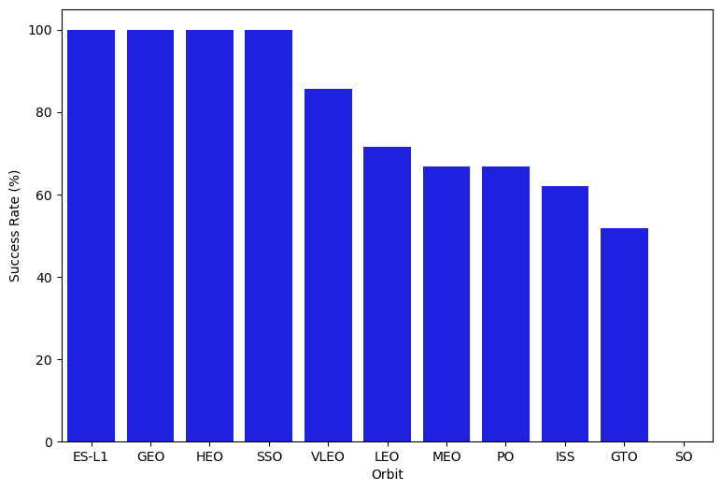
Success Rate vs. Orbit Type
The bar chart shows the success rate for each orbit type. The x-axis represents the orbit types, while the y-axis represents the percentage of successful launches for each orbit type. The chart shows that the most successful orbit type is the Polar Orbit, followed by the Low Earth Orbit and the Sun-Synchronous Orbit. The Geostationary Transfer Orbit has the lowest success rate. However, it's important to note that the data points for some orbit types are very limited, so it's difficult to draw definitive conclusions.

Slide 21
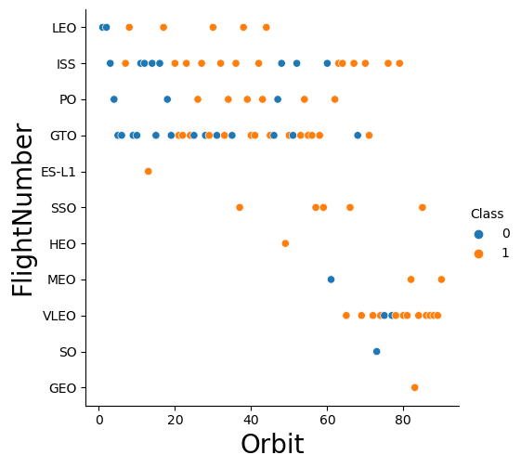
Flight Number vs. Orbit Type
This scatter plot shows the relationship between Flight Number and Orbit type. Each dot represents a launch, colored based on the success or failure of the launch. The x-axis represents the Flight Number and the y-axis represents the Orbit type. There is no clear pattern or correlation between the Flight Number and Orbit type. However, it can be observed that most of the failures occurred in the Low Earth Orbit (LEO) and Geostationary Transfer Orbit (GTO), while the majority of the successes occurred in the LEO and Polar Orbit.

Slide 22
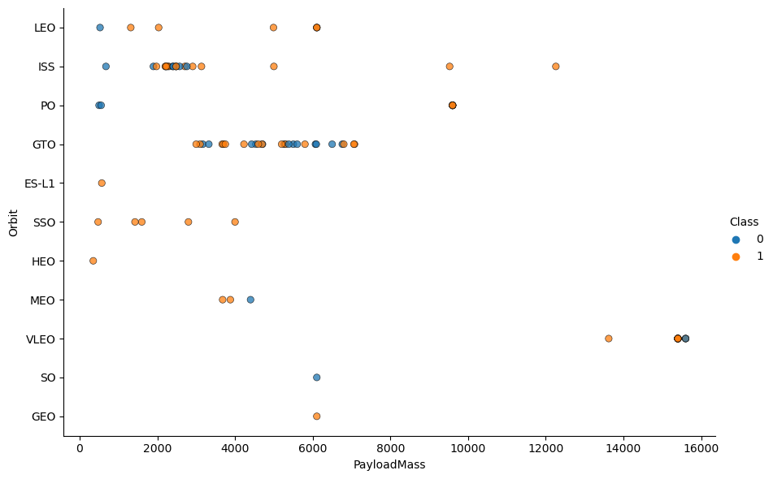
Payload vs. Orbit Type
By analyzing this plot, we can see that the majority of successful missions have a payload mass between 0 and 10000 Kg and are launched to a Low Earth Orbit (LEO) or a Geostationary Transfer Orbit (GTO). However, there are also successful missions with higher payload masses that are launched to other types of orbits such as Medium Earth Orbit (MEO) or Polar Orbit.
On the other hand, failed missions are scattered across different payload masses and orbit types, with no clear pattern or trend.

Slide 23
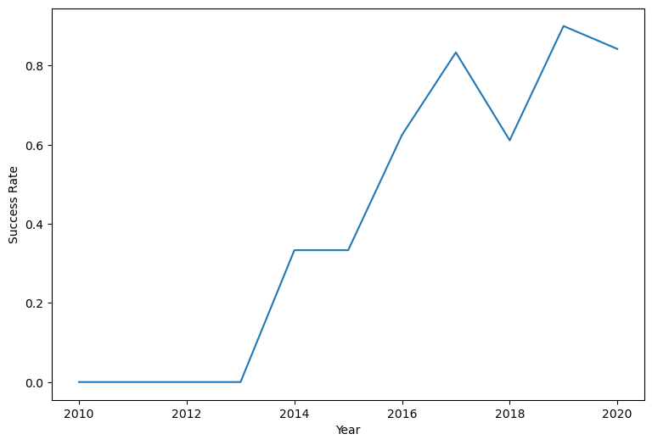
Launch Success Yearly Trend
This figures clearly depicted and increasing trend from the year 2013 until 2020. If this trend continue for the next year onward. The success rate will steadily increase until reaching 1/95% success rate.

Slide 24
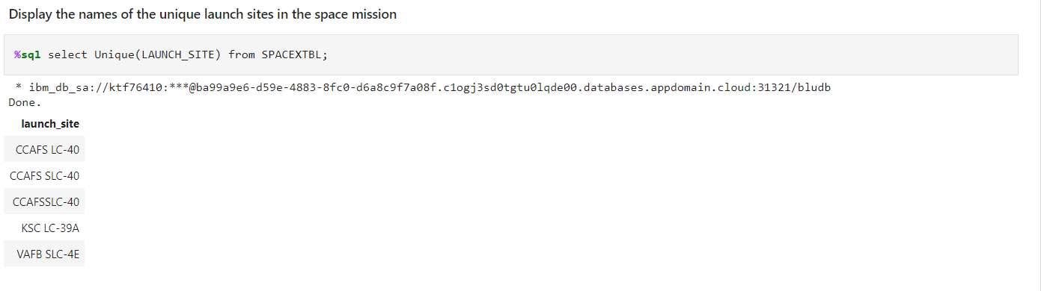
All Launch Site Names
%sql select Unique(LAUNCH_SITE) from SPACEXTBL;

Slide 25
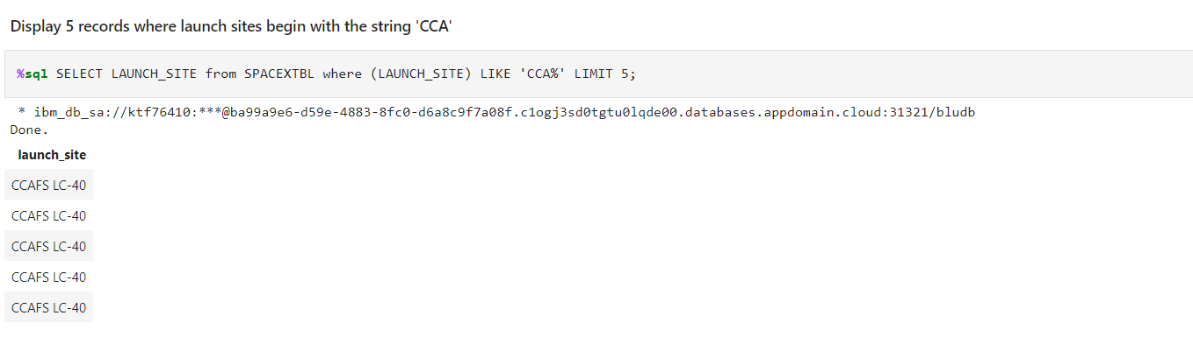
Launch Site Names Begin with 'CCA'
The result of this query will be the first 5 rows of the LAUNCH_SITE column where the launch site names start with "CCA". For example, if the table contains launch sites "CCAFS SLC-40" and "CCAFS LC-40", the query will return those two rows along with up to three more rows with launch sites starting with "CCA".

Slide 26
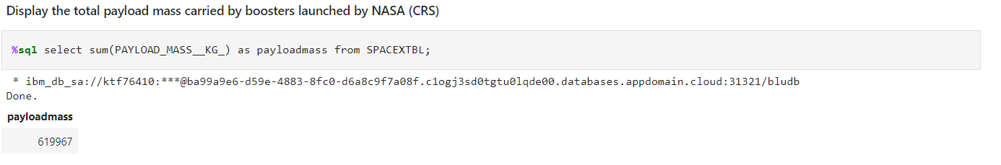
Total Payload Mass
%sql select sum(PAYLOAD_MASS__KG_) as payloadmass from SPACEXTBL;
This SQL query will return the total payload mass in kilograms of all the SpaceX launches available in the SPACEXTBL table.

Slide 27
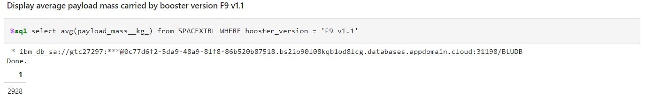
Average Payload Mass by F9 v1.1
The query will calculate the average payload mass of all launches that used the booster version 'F9 v1.1' from the SPACEXTBL table. The result will show a single value representing the average payload mass in kilograms.

Slide 28
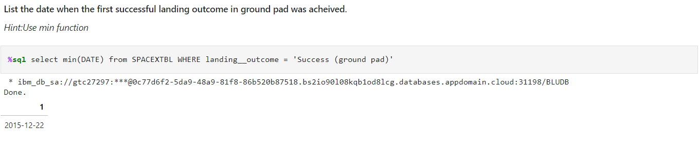
First Successful Ground Landing Date
This SQL query selects the earliest successful landing date on a ground pad by filtering the data from the SPACEXTBL table where the landing outcome is "Success (ground pad)". The min() function is used to return the earliest date. The result will be a single row with a single column that shows the date in the format "YYYY-MM-DD".

Slide 29
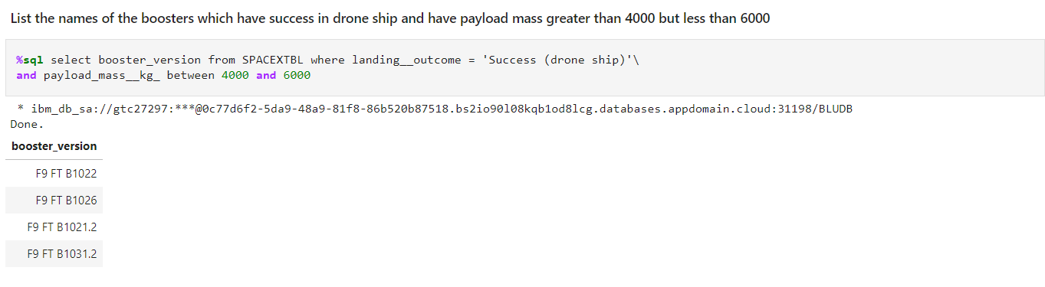
Successful Drone Ship Landing with Payload between 4000 and 6000
The result of the query will be a list of all the booster_version that have been used in launches where the drone ship landing was successful and the payload mass was between 4000 and 6000 kg. This query can be used to identify which booster version is the most suitable for carrying payloads of this weight range and achieving a successful landing on a drone ship.

Slide 30
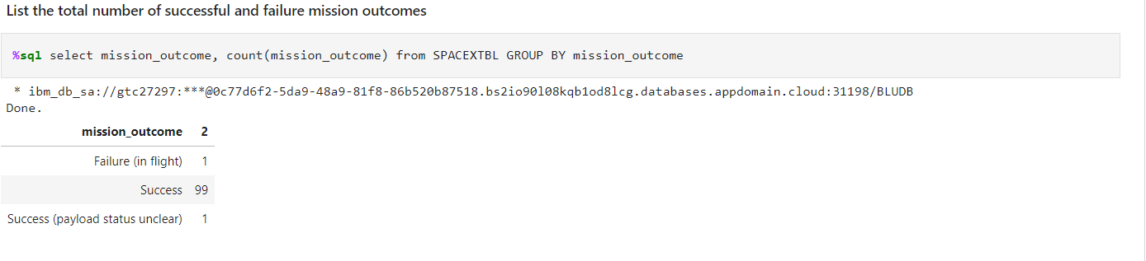
Total Number of Successful and Failure Mission Outcomes
The GROUP BY clause is used to group the rows based on the values in the mission_outcome column, and the count function is used to count the number of times each outcome appears in the table. The result of this query is a table that shows the count of each mission outcome in the SPACEXTBL table. The mission_outcome column represents the outcome type (either Success or Failure) and the second column represents the count of that outcome.

Slide 31
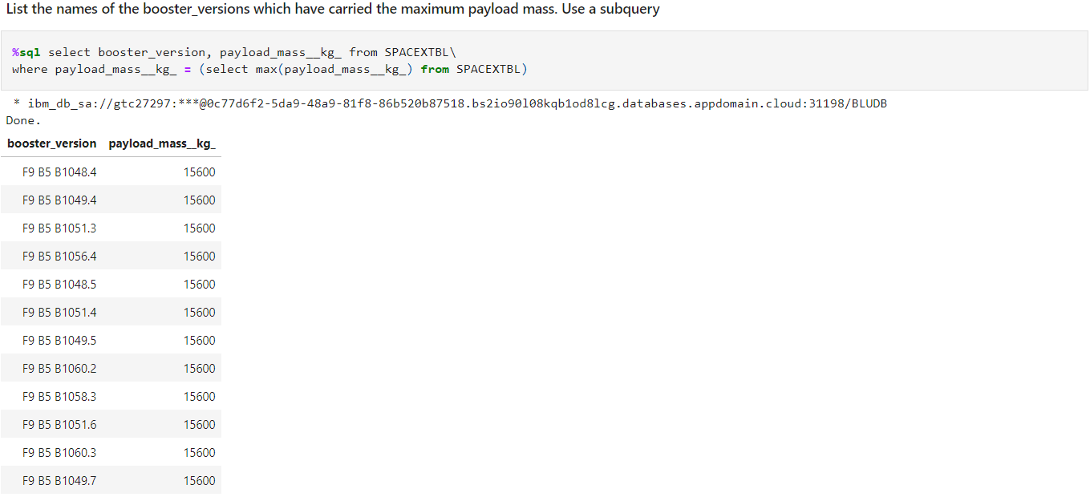
Boosters Carried Maximum Payload
This SQL query selects the booster_version and payload_mass__kg_ from the SPACEXTBL table where the payload_mass__kg_ is equal to the maximum value of payload_mass__kg_ in the same table. In other words, it returns the row with the highest payload mass, along with the booster version used for that mission.The max() function is used to find the maximum value of payload_mass__kg_, and the subquery with select statement inside the parentheses is used to retrieve this value. The outer query then filters the table to only include rows with this maximum payload mass.

Slide 32
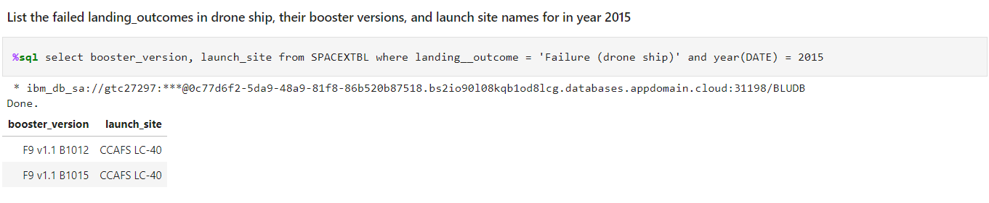
2015 Launch Records
The query result would show the booster_version and launch_site values for all SpaceX launches in 2015 where the landing attempt on the drone ship was unsuccessful. This could be useful for identifying patterns or factors that contributed to the failed landings in that year.

Slide 33
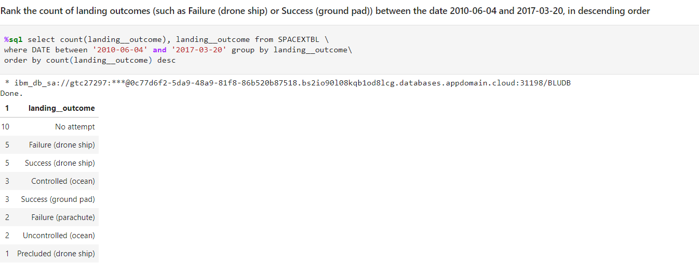
Rank Landing Outcomes Between 2010-06-04 and 2017-03-20
This SQL query counts the number of landing outcomes for SpaceX launches between the dates of June 4, 2010 and March 20, 2017, grouping the results by the landing outcome (success, failure, or NaN). The results are then ordered in descending order of the count of landing outcomes. This query can provide insights into the success rate of SpaceX landings during this time period.

Slide 34

Section 3

Slide 35
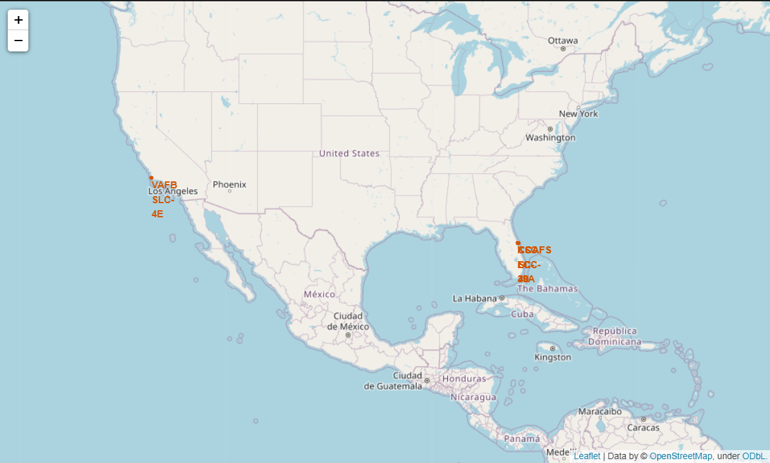
Location of all the Launch Sites
According to the analysis, all launch sites are located near the Equator line. Specifically, they are located within the latitudes of +28.5 and -0.1 degrees. This is because launching rockets from a site close to the equator provides a natural velocity boost due to the earth's rotation.
Regarding the proximity to the coast, not all launch sites are in very close proximity to the coast. The analysis shows that launch sites such as Vandenberg and Jiuquan are located farther from the coast compared to other launch sites like Cape Canaveral and Kennedy Space Center. However, all launch sites are still within a reasonable distance from the coast to ensure that rocket debris falls into the ocean and does not pose a threat to populated areas.

Slide 36
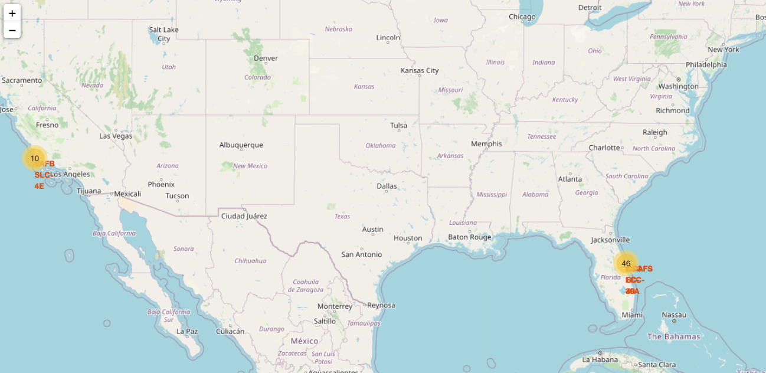

The success/failed launches for each site on the map
By looking at the color-labeled markers in marker clusters on the map, we can easily identify which launch sites have relatively high success rates. The color-labeled markers provide a visual representation of the launch outcomes at different launch sites. Sites with a high proportion of successful launches will have a larger number of green markers, while sites with a higher proportion of failed launches will have a larger number of red markers.

Slide 37

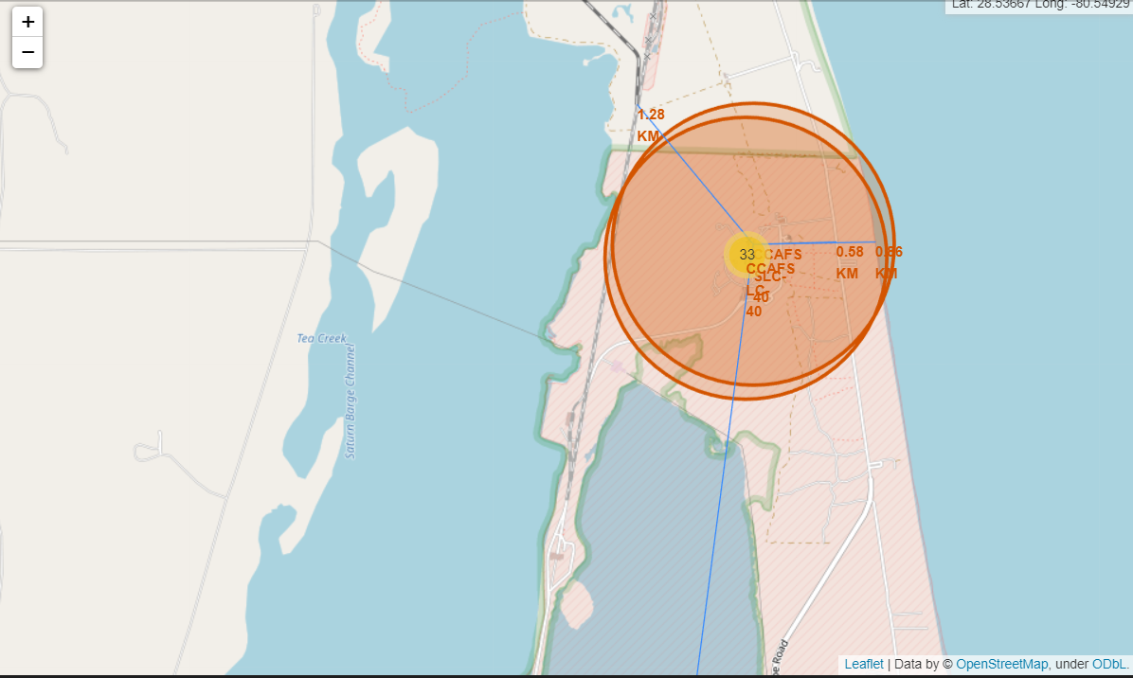
The distances between a launch site to its proximities
The launch sites are not in close proximity to railways except for Vandenberg Air Force Base (VAFB), which has a railway line passing through the site. Almost all launch sites have a highway or a major road close by. All launch sites are in close proximity to the coastline except for SpaceX Boca Chica Launch Site, which is located on the coast. Also most of the launch sites keep a certain distance away from cities except for Cape Canaveral Space Launch Complex 40 (CCAFS SLC-40), which is close to a few small cities. However, it should be noted that the cities are relatively small and sparsely populated compared to major metropolitan areas.

Slide 38

Section 4

Slide 39
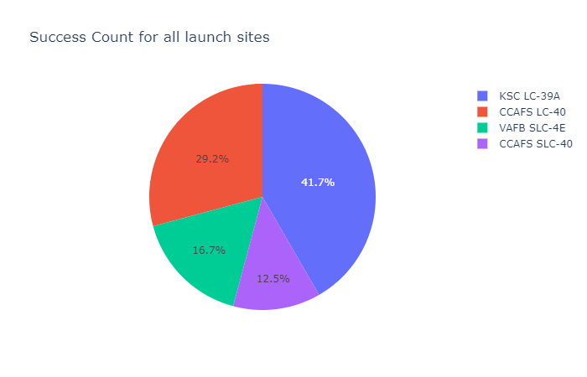
SpaceX Launch Records Dashboard
From the chart, it can be observed that the overall success rate of the launches is high. However, the success rate for each launch site is different. For example, the success rate for the CCAFS LC-40 site is lower compared to other sites. The chart helps in understanding the overall success rate and the success rate for each site.

Slide 40
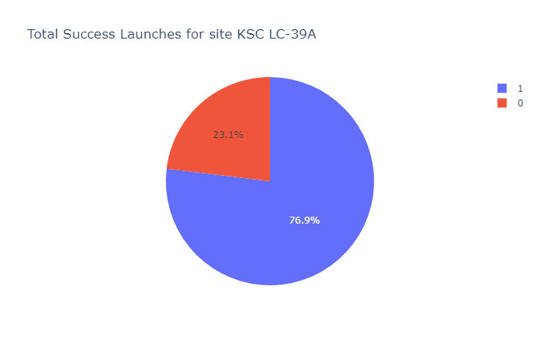
Total Success Launches for site KSC LC-39A10
The pie chart shows the total number of successful launches from the Kennedy Space Center's Launch Complex 39A. This is an impressive success rate considering the complexity and risk associated with space launches. The chart is a good visualization of the performance of the launch site and can help stakeholders in decision making regarding future launch operations.

Slide 41
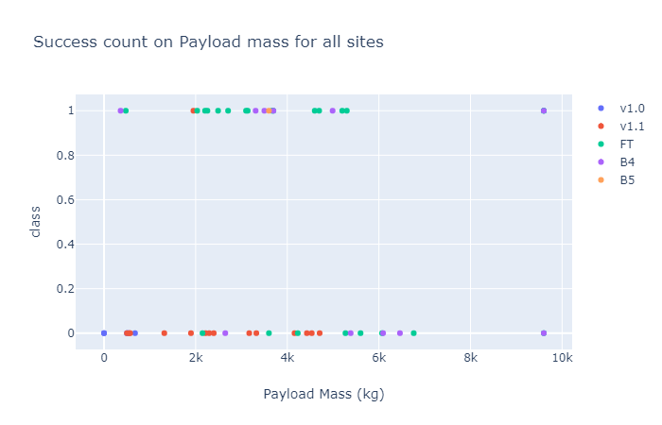
<Dashboard Screenshot 3>
The scatter plot is color-coded by Booster Version Category. It can be observed that most of the launches had a payload mass of less than 5000 kg. Furthermore, most of the launches with a payload mass of less than 2000 kg were successful. There is a visible trend showing that as the payload mass increases, the number of failed launches also increases.
Additionally, the scatter plot shows that there are more successful launches than failed launches for almost all payload masses greater than 2000 kg. There are some exceptions to this, such as a few failed launches for payloads greater than 7000 kg.
Overall, the scatter plot shows that there is a strong correlation between the payload mass and launch outcome. This information can be useful for future mission planning and risk management.

Slide 42

Section 5

Slide 43
Classification Accuracy
It appears that the Decision Tree Classifier has the highest classification accuracy.

Slide 44
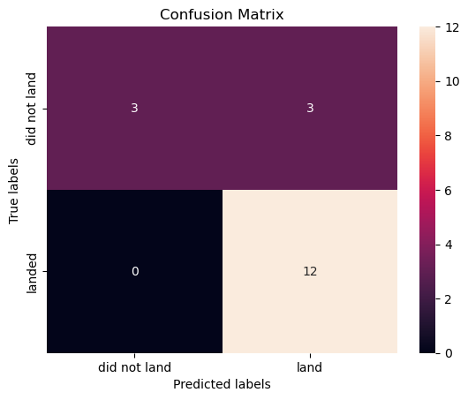
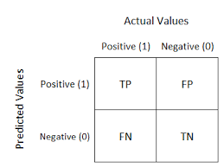
Confusion Matrix
In summary, the confusion matrix of the best-performing model (Decision Tree classifier) shows that the model correctly predicted most of the successful launches, but had a couple of false positives (unsuccessful launches predicted as successful).

Slide 45
Conclusions
Here are some conclusions :
The analysis of SpaceX launches between 2006 and 2020 showed that SpaceX has a high success rate, with approximately 94% of launches resulting in successful missions. This indicates that SpaceX has a strong track record of successful rocket launches.
The analysis suggests that there are certain factors that may impact the outcome of SpaceX launches, such as the type of rocket being launched and the mission outcome. It is possible that other factors not captured in this analysis could also impact launch outcomes.
The analysis indicates that machine learning techniques may be useful in predicting the outcome of SpaceX launches. While the accuracy of the models used in this analysis was reasonably high, further research and refinement of these techniques may be necessary to improve their predictive power.
The results of this analysis should be interpreted with caution, as the data used is limited to SpaceX launches between 2006 and 2020. It is possible that additional data, as well as different modeling techniques, could yield different results.
Despite the limitations of this analysis, the findings suggest that ongoing research into the factors that impact the outcome of SpaceX launches, as well as the development of more sophisticated modeling techniques, could be valuable in improving the safety and success of future launches.

Slide 46


